Slide 1
Neural Networks
Using OOP
Aaron Jencks

Slide 2
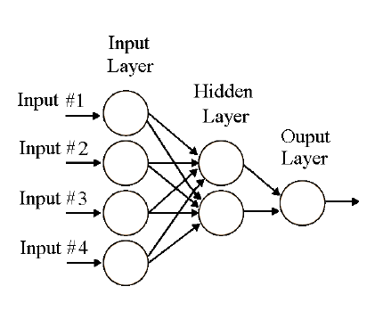
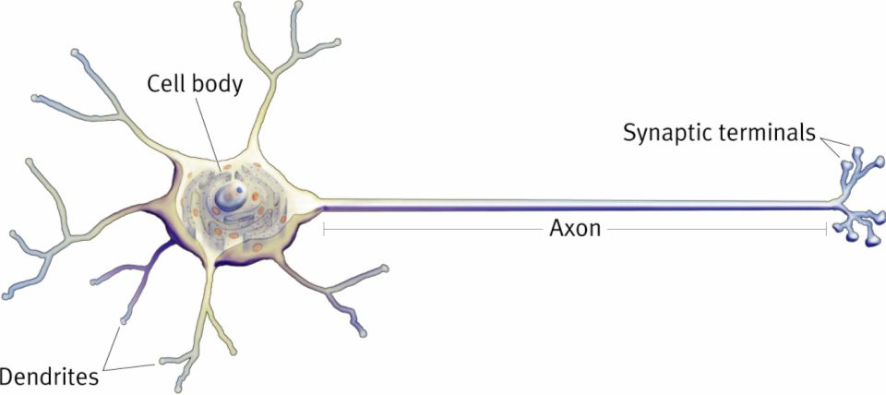
What is a Neural Network?
Collection of Neurons

Slide 3
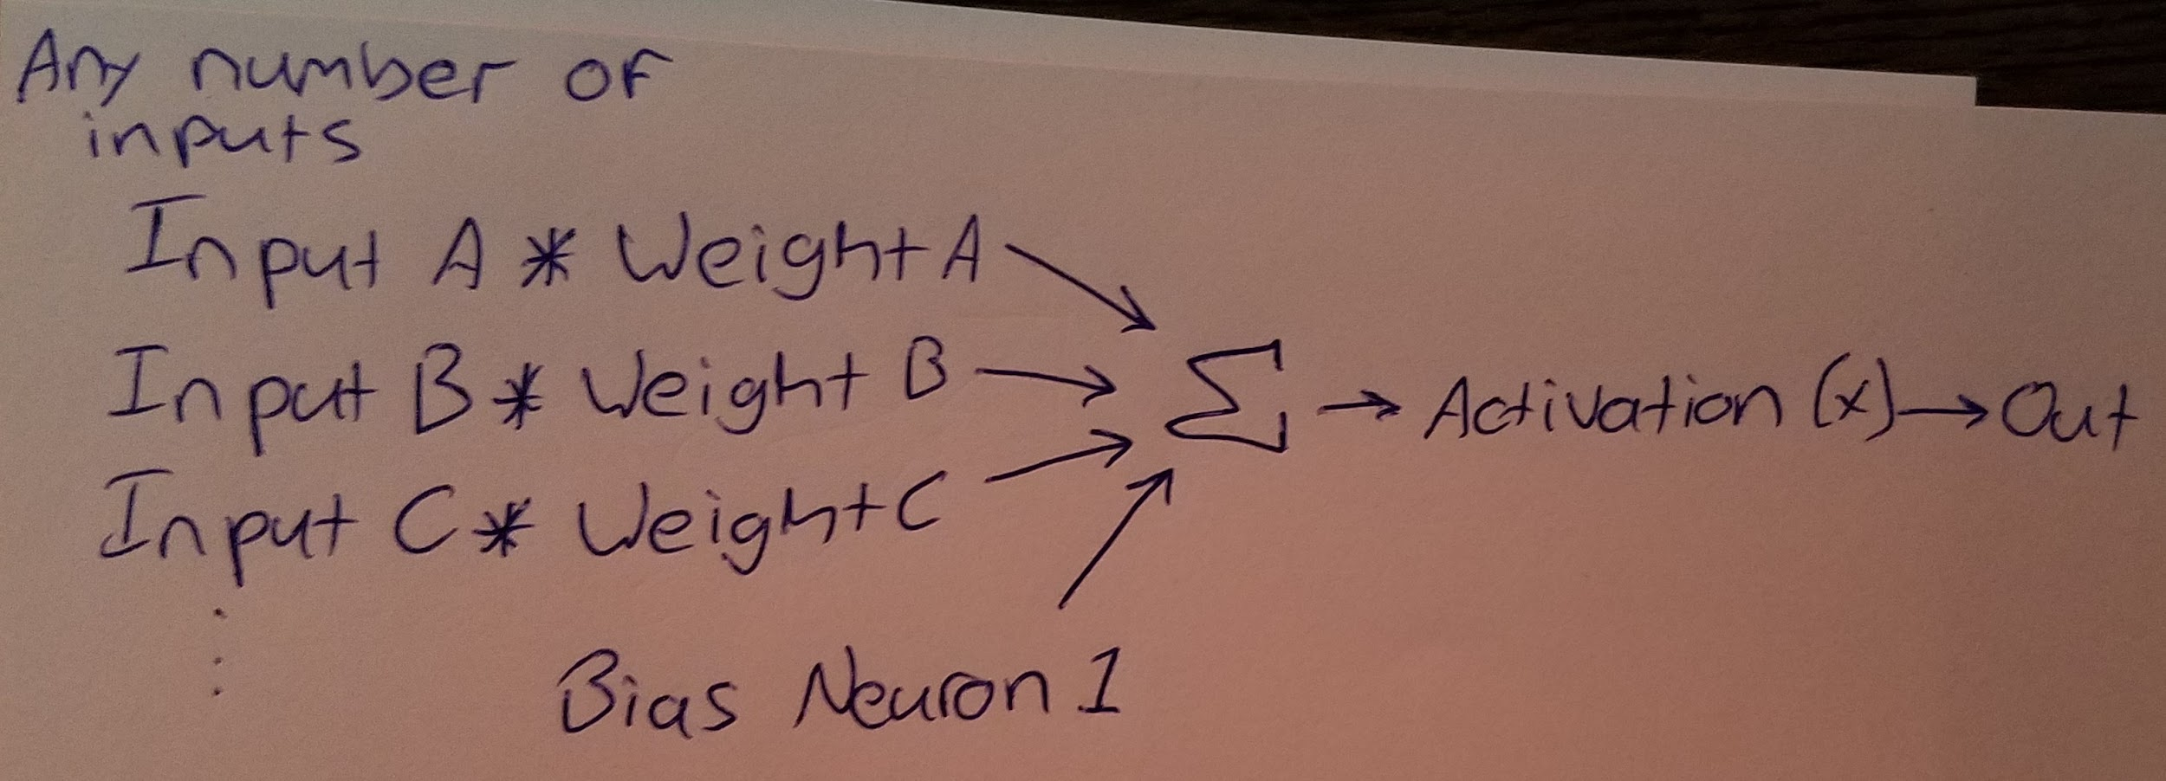
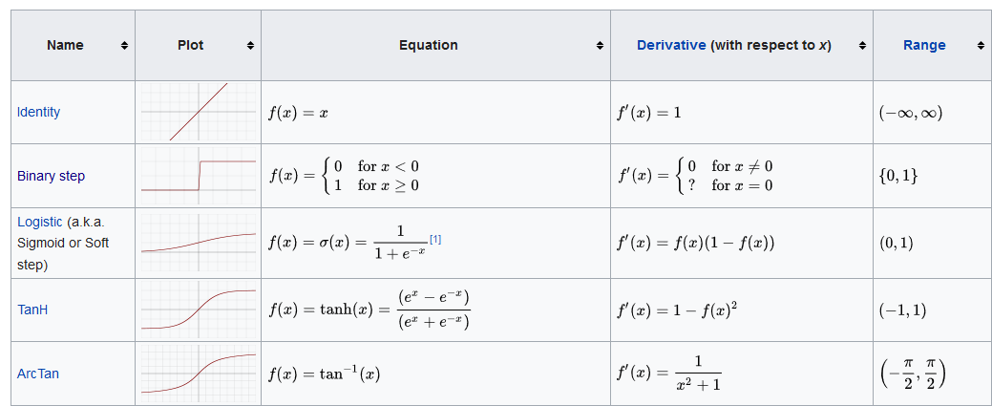
How does it work? (Neuron)
Inputs assigned
Multiply by the weights
Add the bias (y = mx + b)
Activation function

Slide 4
How does it work? (Network)
Inputs assigned
Inputs times the weight, activate
Repeat

Slide 5
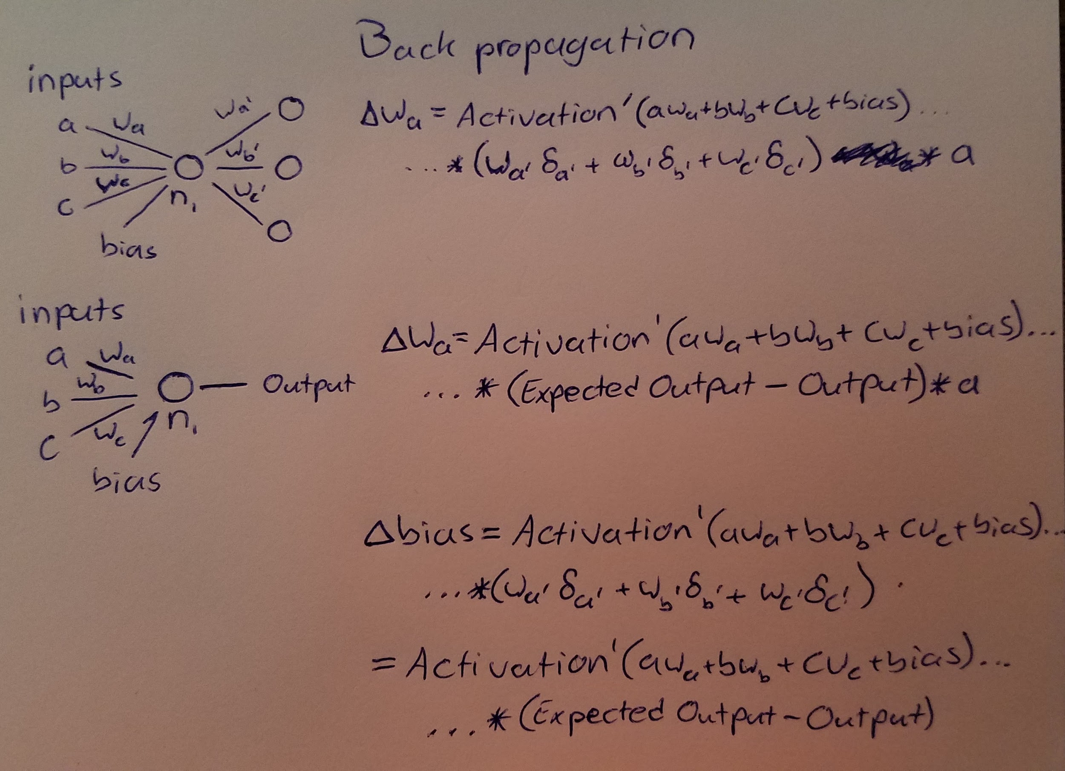
Okay, how does it learn? (Back propagation)
Stochastic
Chain Rule is your friend
Works from the outputs to the inputs
Gradient Descent
Deltas are added to enforce the change
Learning Rate
Momentum
Skipping derivation (will show upon request)

Slide 6
Machine Learning and OOP
There are some 20 different activation functions that can be implemented with any neuron
There are multiple types of neurons (recurrent, normal, convolutional)
There are multiple types of networks
Because training requires the assignment of random numbers, and the chance of success can be quite low, it’s important to be able to save your data.

Slide 7
Overall Topology
Neural Network Class
List of Lists of Neurons
Training Methods
Calculation Methods
Neuron Class
Default types and parameters
Linked to other neurons using events
Uses threads to spread out as fast as possible to avoid bottlenecking
Does the calculus for the Neural Network Class
Activation Function and Parameters Classes
Contains the abstract functions for activation functions
Allows the Neuron class to use any of some 20 different formulas
Does the calculus for the Neuron Class

Slide 8
Visual Demonstration/Tour

Slide 9
Plans for moving forward
Finishing the Recurrent Network update
Finish implementing the Long-Short-Term Memory Cell Class
Implementing a Convolutional Network update
Looking into gpu processing for the training methods using CUDA
Creating a set of API vis for LabVIEW

Slide 10
github.com/iggy12345/Neural-Network-Vault

Slide 11
References
https://www.researchgate.net/figure/Neural-Network-Topology_fig2_259175837
https://towardsdatascience.com/the-mostly-complete-chart-of-neural-networks-explained-3fb6f2367464
A brief Introduction to Machine Learning for Engineers ~ Osvaldo Simeone
Derivation: Error Backpropagation...For Neural Networks ~ Dustin Stansbury
Algebra, Topology, Differential Calculus, and Optimization Theory ~ Jean Gallier and Jocelyn Quaintance
Neural Networks, Manifolds and topology ~ Colah’s Blog
The rest can be found in the research folder of the github repository.

